Slide 2
%80’i Teknik, 96 Personel ile
Turizm Sektörünün İhtiyaçları Konusunda Uzmanlaşmış Bir Kadroya Sahiptir

Slide 3
Ar-Ge Merkezimiz
Antalya Teknokent’teki
Ar-Ge merkezimiz

Slide 4
Yazılım Ekibimiz
Her Biri Konusunda Uzman Yazılımcılarımız ile
En İyi Çözümleri, En Güncel Teknoloji İle Uyguluyoruz

Slide 5
Eğitim ve Destek Ekibimiz
50+ Destek Ekibimiz İle 7/24 Destek Hizmeti Sağlıyoruz

Slide 7
All–In–One Solution
EasyPMS is the most comprehensive cloud hotel management software on the market; it is a full PMS including booking engine, channel manager, rate manager, POS, and other additional modules. It has all the features and functions your hotel may need.

Slide 8
Cloud and Web-Based
EasyPMS is hosted by Microsoft Azure and can be used by any web browser therefore it is accessible from any computer or mobile device anywhere in the world. Compared to on-premise systems, it is much more efficient due to its on-the-go accessibility.

Slide 9
Latest Technology
EasyPMS uses the latest technology (Google’s Angular Framework, Reactive Web Programing and NodeJS) that is why it is extremely fast, efficient, and compatible with all devices and browsers.

Slide 10
Cost Effective & High ROI
EasyPMS has cloud hosting and SaaS license therefore it does not need any server, expensive licenses nor any maintenance or upgrade costs. That is why it is very cost effective and has the highest ROI.

Slide 11
Reliable
EasyPMS is hosted in Microsoft Azure Cloud Servers that may be the most powerful and protected data centers in the world. It is backed up in more than 24 points in the world.

Slide 12
Secure
EasyPMS uses SSL for data transfer, secure tokens for authentication mechanisms, and several AI guard algorithms for malicious attacks. It is one of the best protected systems in the world.

Slide 13
Easy To Use
Since EasyPMS uses Google’s Material Design which has a very familiar interface, it is both user-friendly and easy to use.

Slide 14
Mobile
It is completely responsive and fully functional on tablets and phones in addition to desktop systems.

Slide 15
Multi Property
EasyPMS has many special functions and reports for group hotels and chains. It provides shared consolidated reports for occupancy, income, ADR, and aggregation of financial statements. It also provides shared use of information about guests, agencies, and reservations.

Slide 16
Customizable
EasyPMS is easily customizable for any size and type of hotel due to its flexible parameters.

Slide 17
Scalable
Since it is hosted in cloud servers, CPU power and storage capacity can be easily expanded or decreased depending on your needs.

Slide 18
Interoperatable
EasyPMS has a public API for communication with other systems, so integration to other external systems such as banks, door locks, and pay TV etc. can easily be done.

Slide 19
Enhanced Support
EasyPMS has 24×7 online support; an expert will be with you looking at the same screen anytime you need.

Slide 20
Reservation
Front Desk
Front Cash
Housekeeping
Technical Service
CRM
Night Audit
Contract Management
Sales & Marketing
Banquet & Catering
Integration with PBX, Door Lock, Pay TV
Accounting
Reports
Online Check-in
ID & Passport Reader
PMS
CHANNEL MANAGER
BOOKING ENGINE
RATE MANAGER
POINT OF SALE (POS)
SPA MANAGER

Slide 21
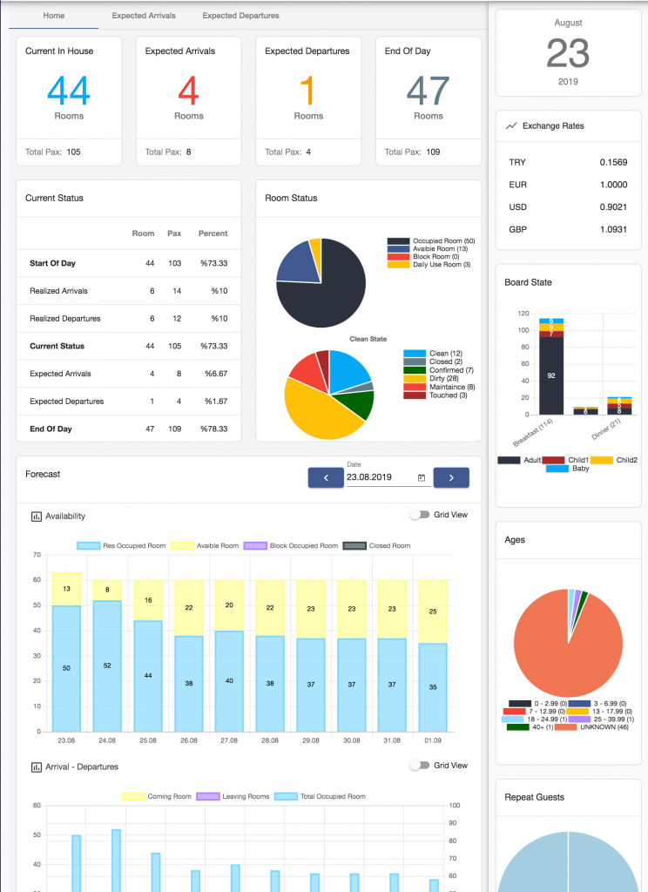
DAILY STATUS
Daily status window provides all critical information about the hotel on a single screen.
You can view your hotel’s occupancy, revenue, forecast, even call center notes both in graphs and lists.

Slide 22
RESERVATION

Slide 23
RESERVATION
You can list, sort, group, and filter all of your reservations by any criteria with a single click.
By the help of color codes, important information becomes more visible.
All functions are accessible with a single click after selecting a single line or multiple lines.
All screens can be exported to Excel or to the printer in different formats.
In the listings multiple sorting, filtering, searching, grouping are standardized.
Thanks to its digital archiving capability, one or more documents can be stored in the related record by scanning or uploading.
Users can view only the allowed screens and run the allowed functions depending on their authority.

Slide 24
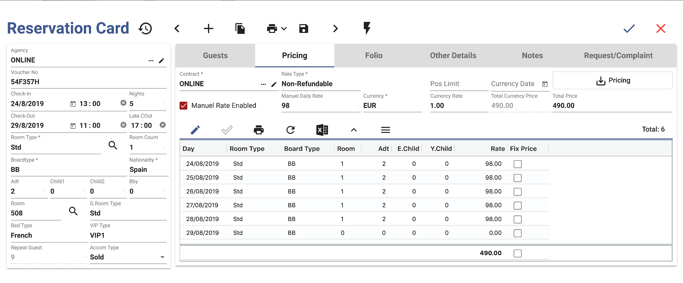
RESERVATION CARD
All details about the reservation are in one place.
No more duplicate guest profiles. Auto guest lookup feature finds old profiles and puts them together.
There is access to room type availability for the current reservation period with a touch of a button.
It has the ability to block rooms with one click.
It has unlimited profile recording ability.
There is authority control for access to the pricing tab; all data related to pricing is in one place.

Slide 25
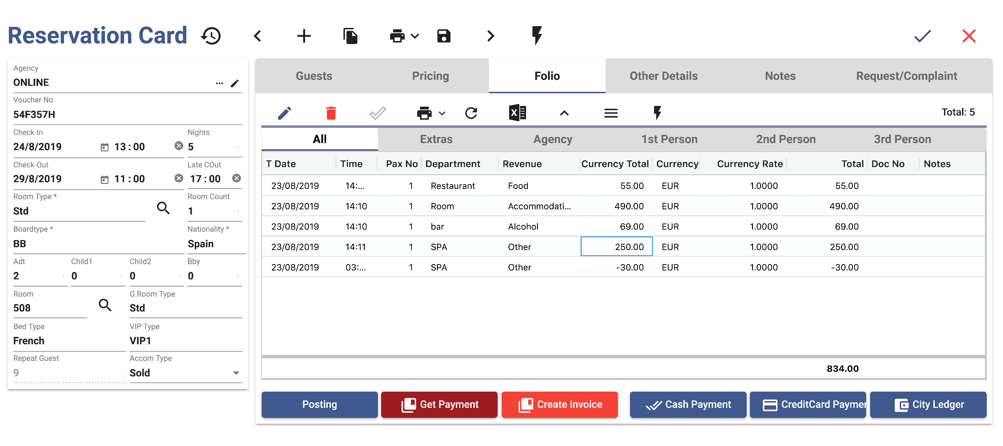
FOLIO
Since payment, posting and invoicing can be done by a touch of a single button, it saves times.
Transactions can be entered in different currencies and it provides automatic conversion.

Slide 26
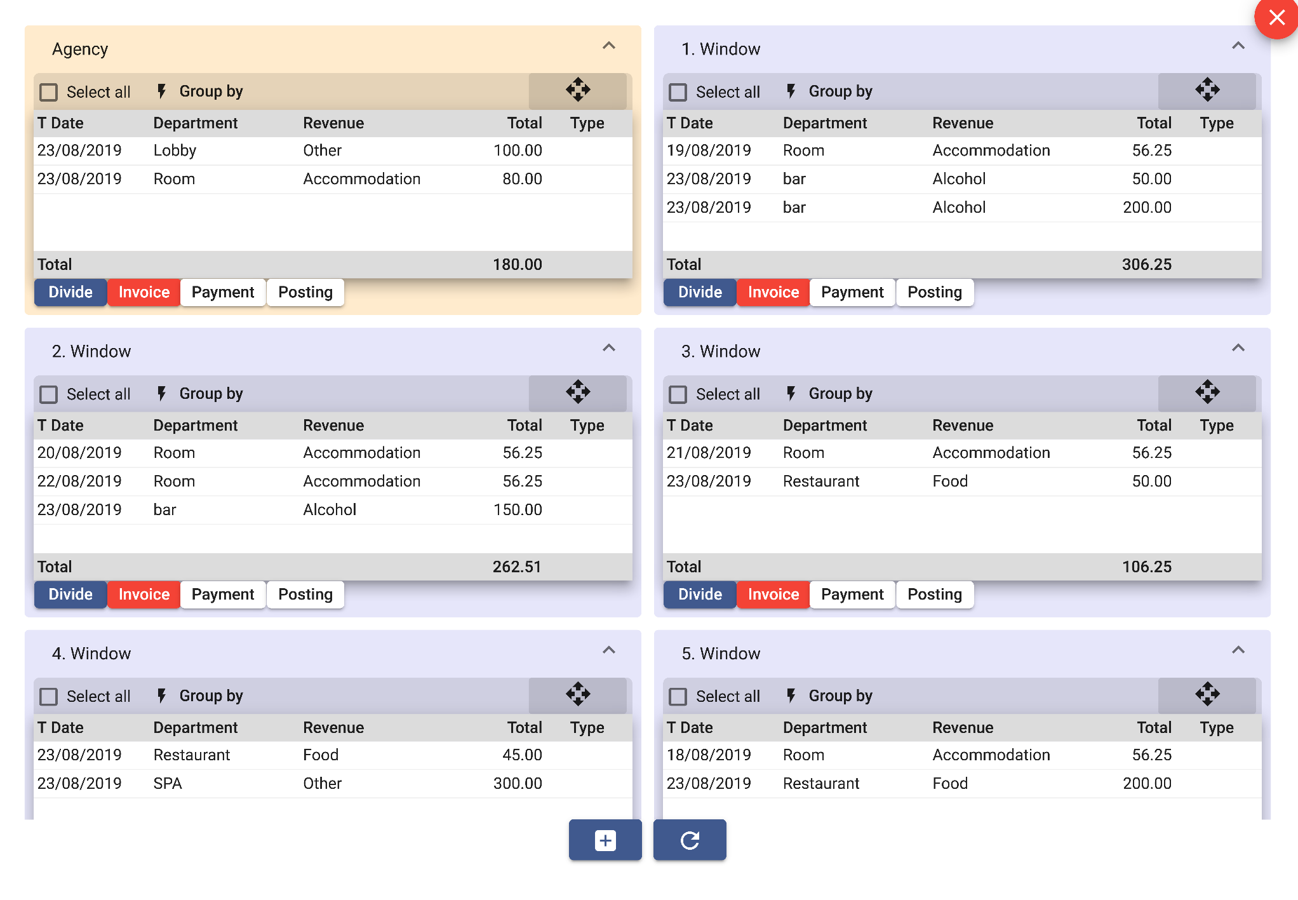
FOLIO
The room folio can be distributed to many different windows and each window can be separately billed.

Slide 27
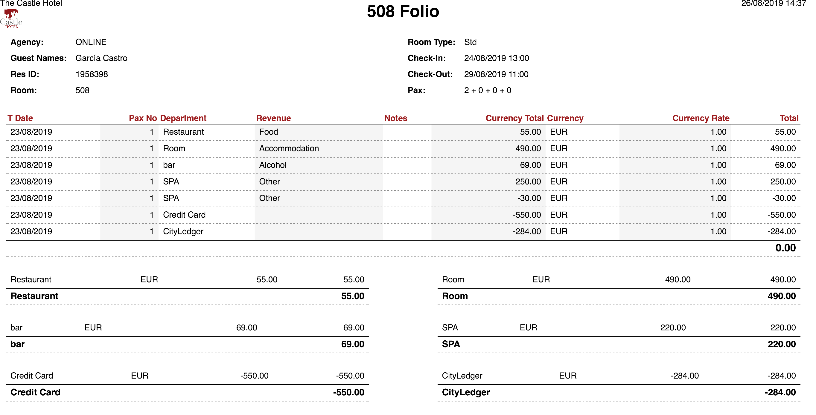
FOLIO
Different types of folio print outs can be taken.

Slide 28
CRM – GUEST RELATION

Slide 29
CRM – GUEST RELATION
İş Akış Şeması
TASK MANAGEMENT
Request
Task
Work
Control
All requests and complaints entered get included to the automatic task management.
The expected completion time is determined according to the definition of the task, the department, the authority, and the importance.
The task falls to the screen of the relevant unit or mobile device. The person receiving the call starts by pressing the “start task” button and ends by pressing the “complete ” button.
If the task is not scheduled and/or does not end in the max time frame, the message is automatically sent to a higher authority.

Slide 30
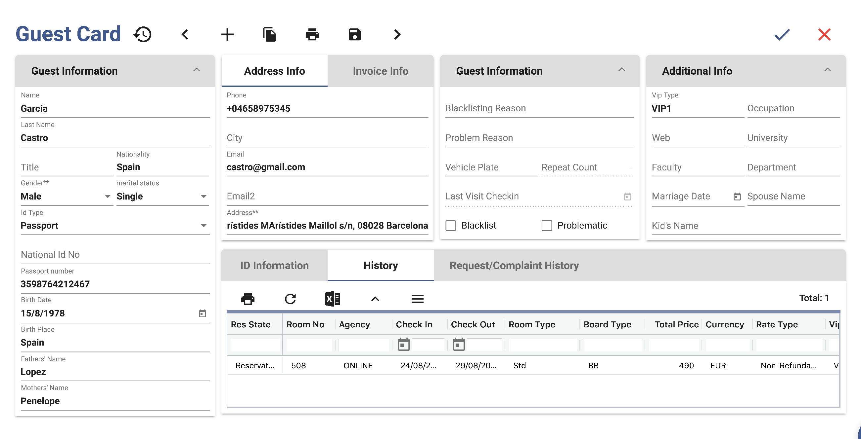
CRM – GUEST RELATION
The transactions related to the guests can also be tracked through the reservation card and if requested, it automatically reminds you these transactions during check-in, check-out, folio, and invoicing.
Operations like VIP, setup, and prepay control get defined both as a reminder and as a task to the relevant section.

Slide 31
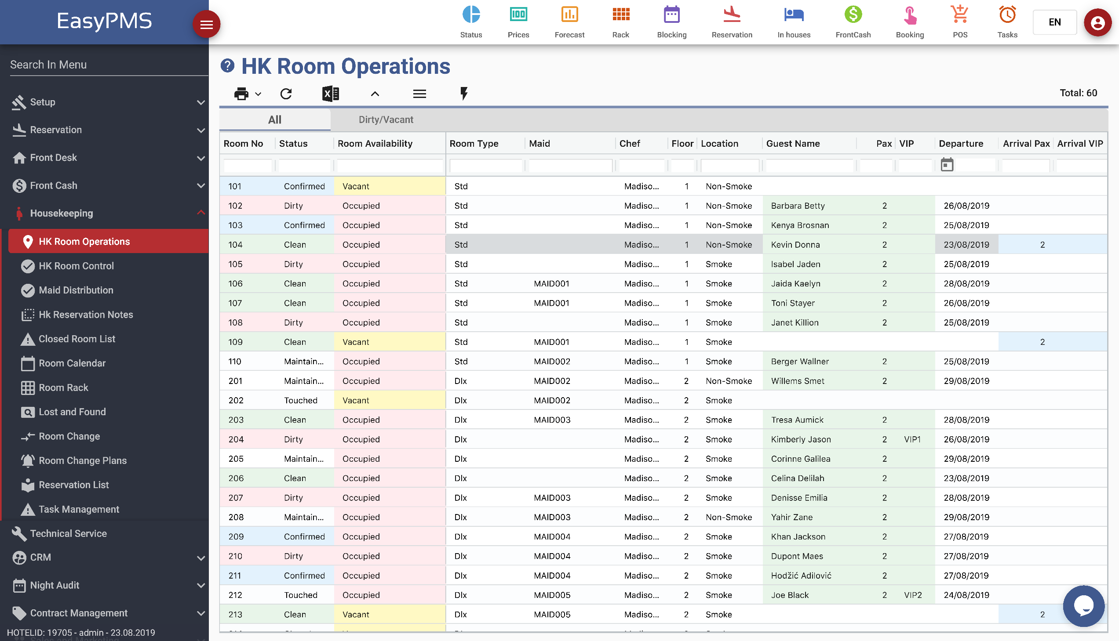
HOUSEKEEPING

Slide 32
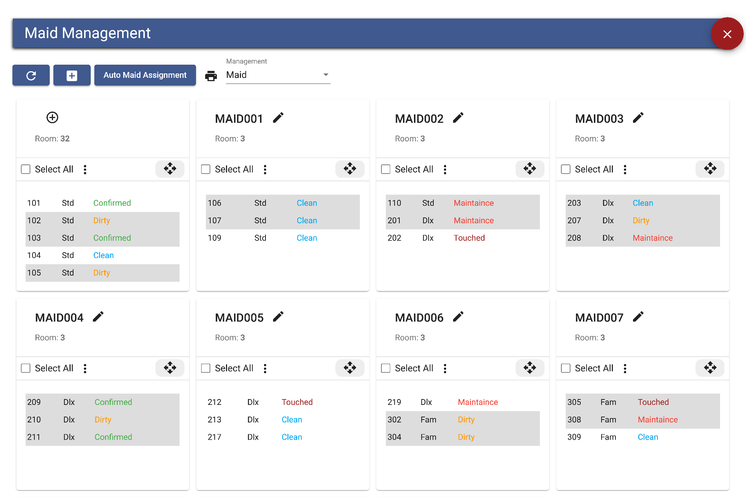
HOUSEKEEPING
You can carry out all housekeeping processes in a digital environment.
You can instantly update your rooms’ dirty-clean and minibar statuses, make an efficient job distribution to your housekeepers, and make performance evaluations easily.
There is automatic and/or manual drag-and-drop distribution of the rooms among the maids.

Slide 33
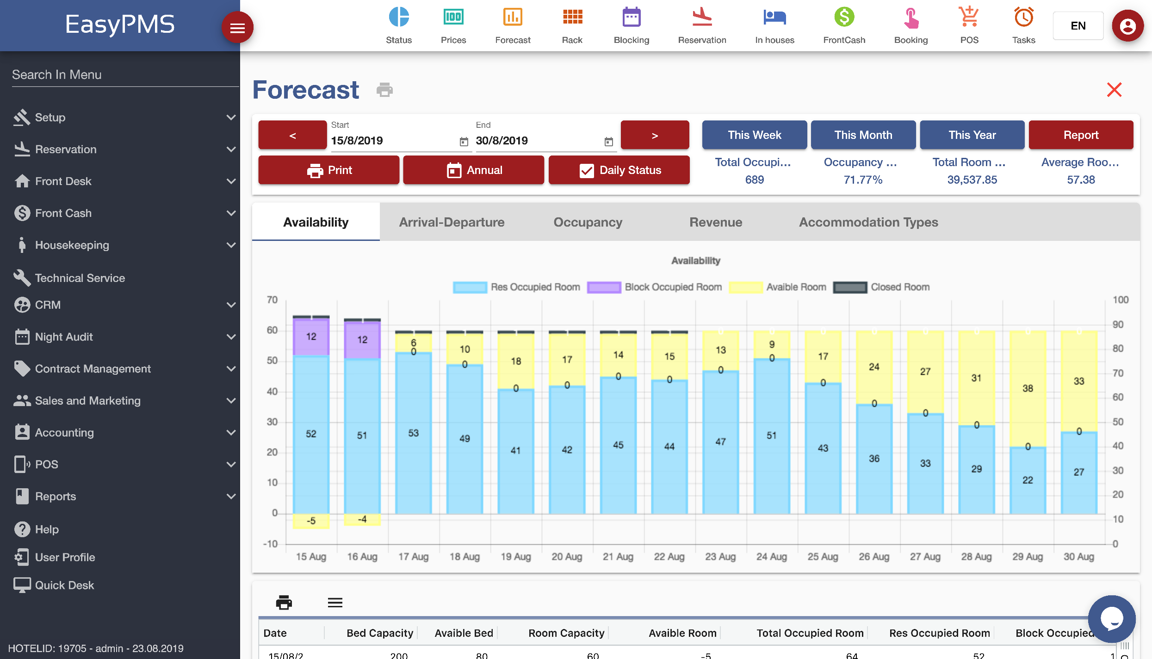
FORECAST & ANALYSIS
It shows the occupancy, activity, income, and ADR graphs for the selected time period.
EasyPMS allows you to get forecasts based on every detail you enter on the reservation card.

Slide 34
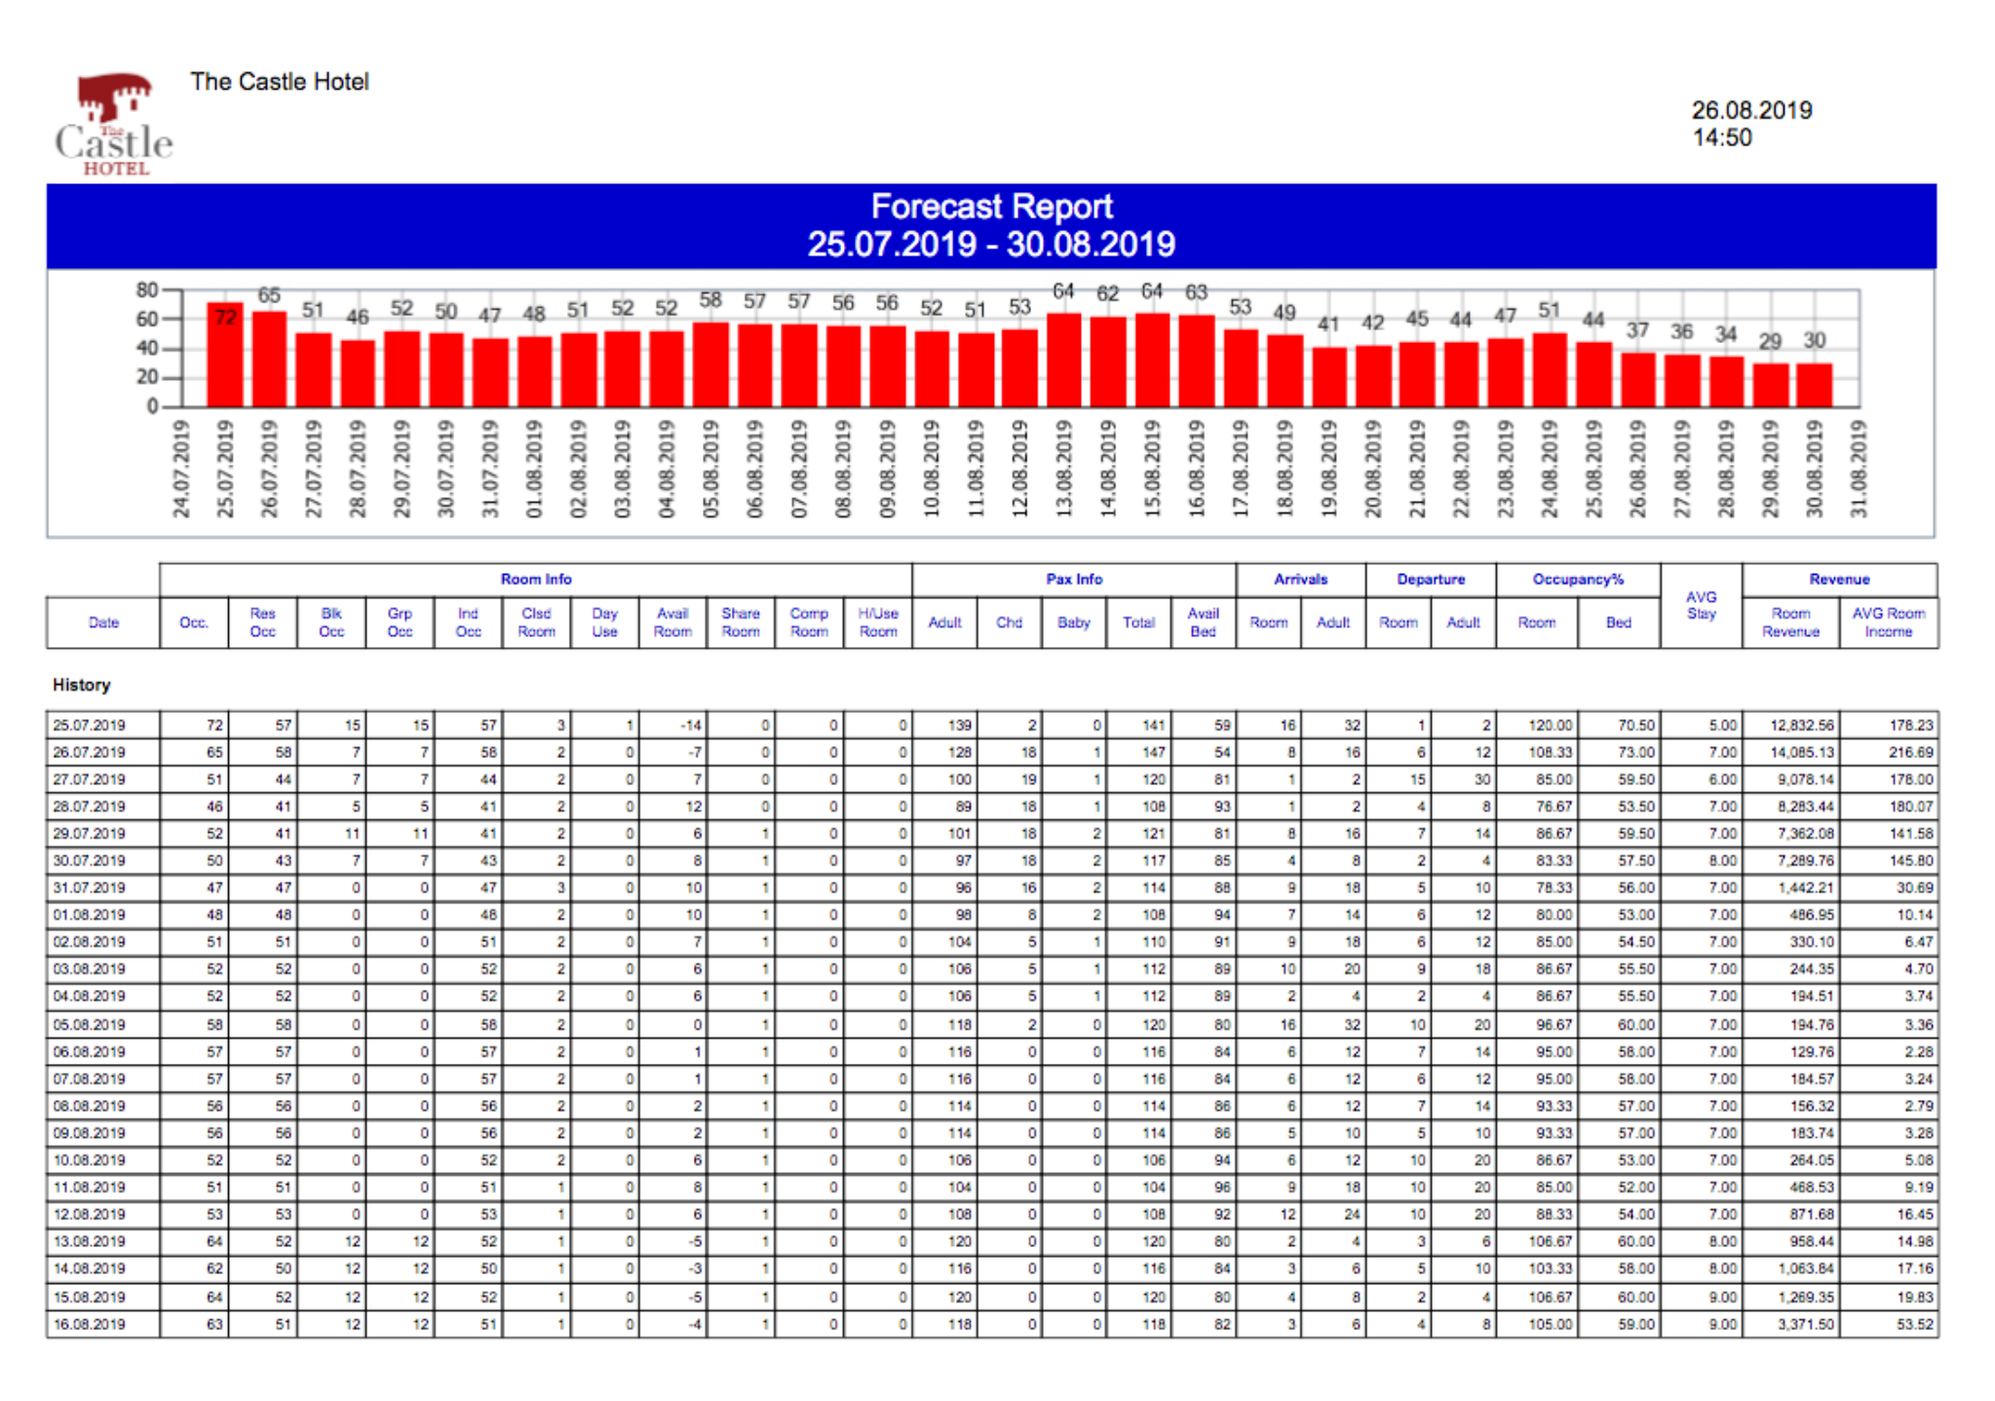
FORECAST & ANALYSIS
You can see past and future occupancy information with a single button.

Slide 35
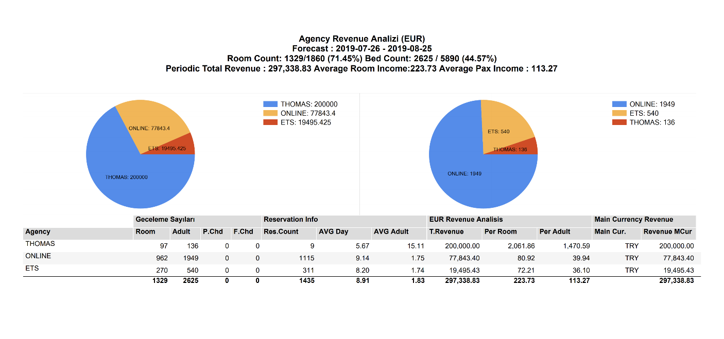
FORECAST & ANALYSIS
You can access all the statistical information about the agencies, income, and accommodation all on one screen.

Slide 36
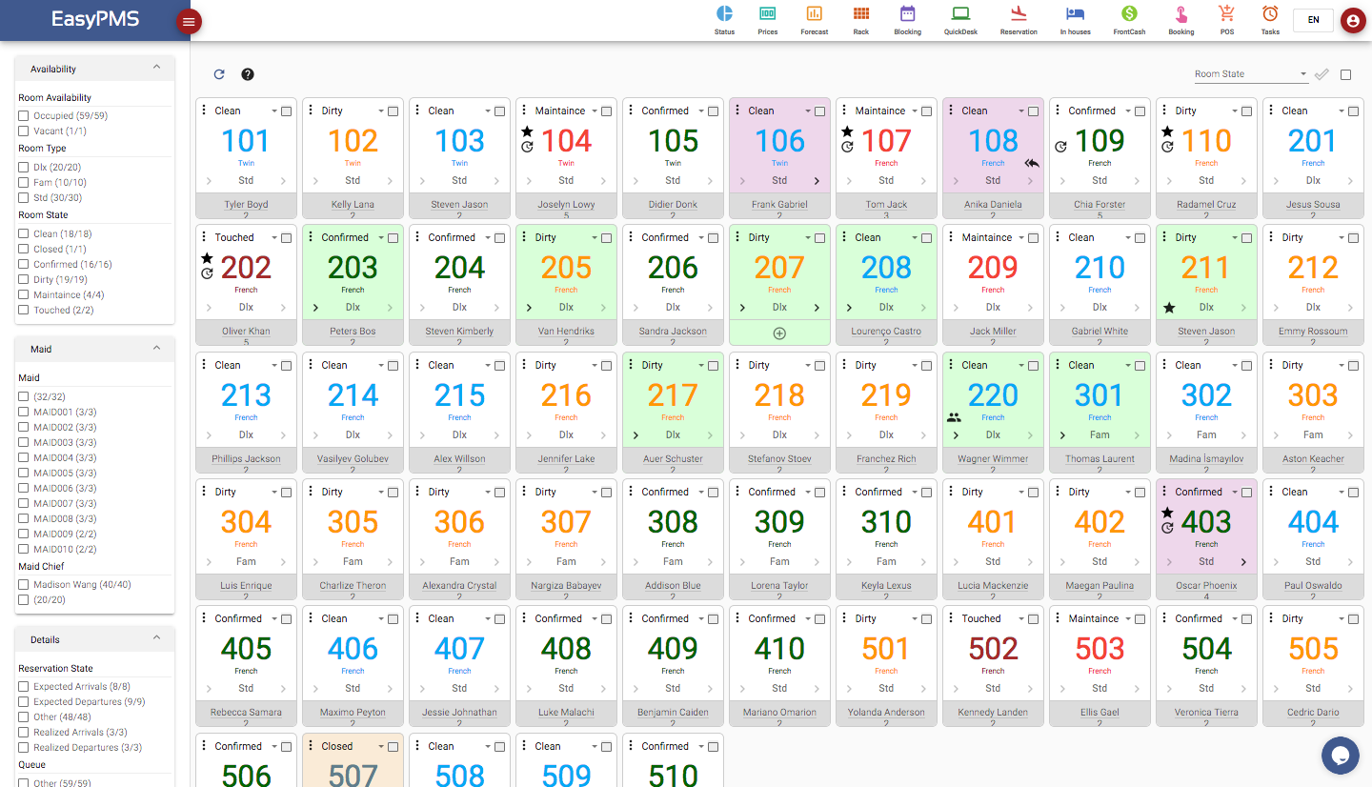
ROOM RACK
You can view instant room statuses and color code them according to cleanliness and occupancy on one screen.
You can easily filter the displayed rooms, access arrivals, departures, and in-house information.
You can get payments and do folio and checkout operations on the room you selected without leaving this screen.
You can label rooms using visual icons for VIP and late check-in and check-outs.

Slide 37
ROOM CALENDAR
Room Calender

Slide 38
ROOM CALENDAR
It is designed in such a way that you can perform the entire operation of the front office (Reservation, Check-in, Check-out, Folio, Blockage, Payments)
You can access the guest’s reservation card, change room and date with a drag and drop, make collections, check-in/check-out transaction entry, and go to the folio.
You can easily drag and drop a reservation around to modify its room number or accommodation range.
You can also see your reservations from the online channels that yet not have been assigned a room on top of the blockage screen and drag and drop them to the suitable room.
The number of empty rooms is displayed at the bottom of the room type and the full occupancy can be seen on top of the chart.
On this same screen, online channels can be managed and POS transactions can be processed.

Slide 39
INVOICE & ACCOUNTS RECEIVABLE
EasyPMS allows you to easily perform preliminary accounting transactions such as current account, credit-debit follow-up, cash follow-up, personnel account follow-up, invoice and waybill issuance, and follow-up of checks and promissory notes.

Slide 40
SALES PROJECTS
You can monitor all your sales projects on a single screen.
You can follow up corporate/company meetings, offers and contracts, collective reservations and banquet sales, and make income analysis.

Slide 41
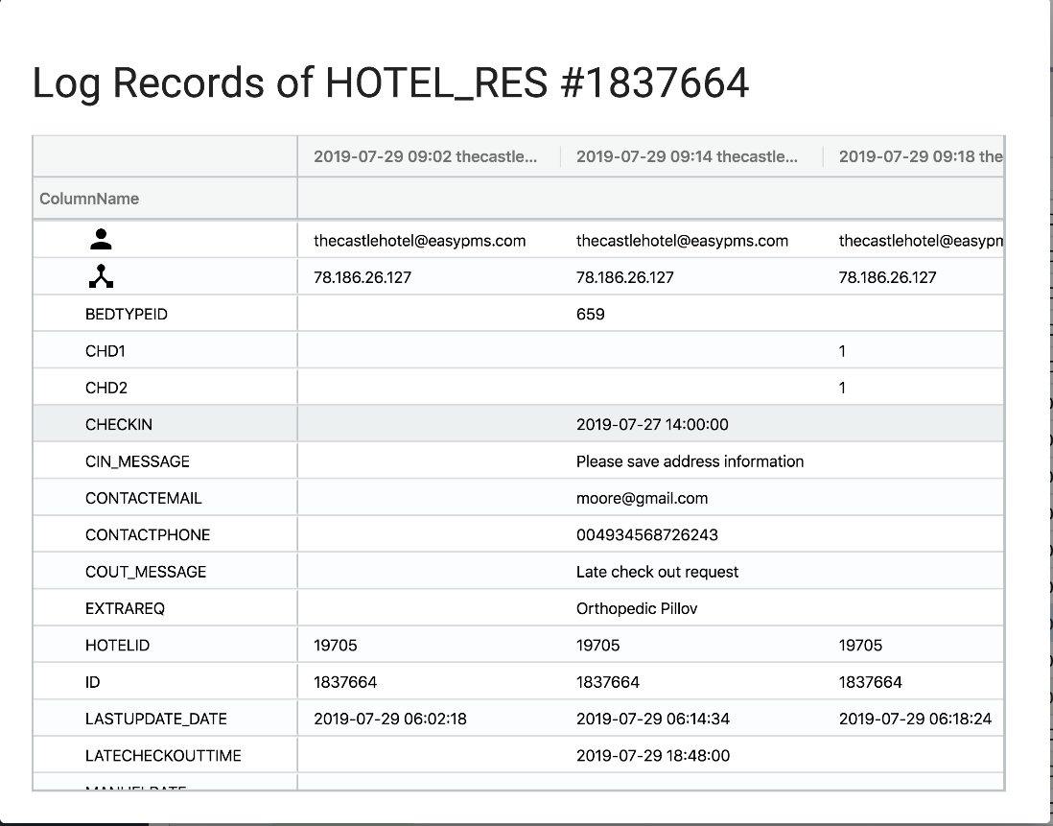
DETAILED AUTHORIZATION & LOGGING
By defining roles to users, you can easily limit their visibility and transaction privileges on all screens.
You can also use logging feature to track all the changes made on IP and user basis.

Slide 42
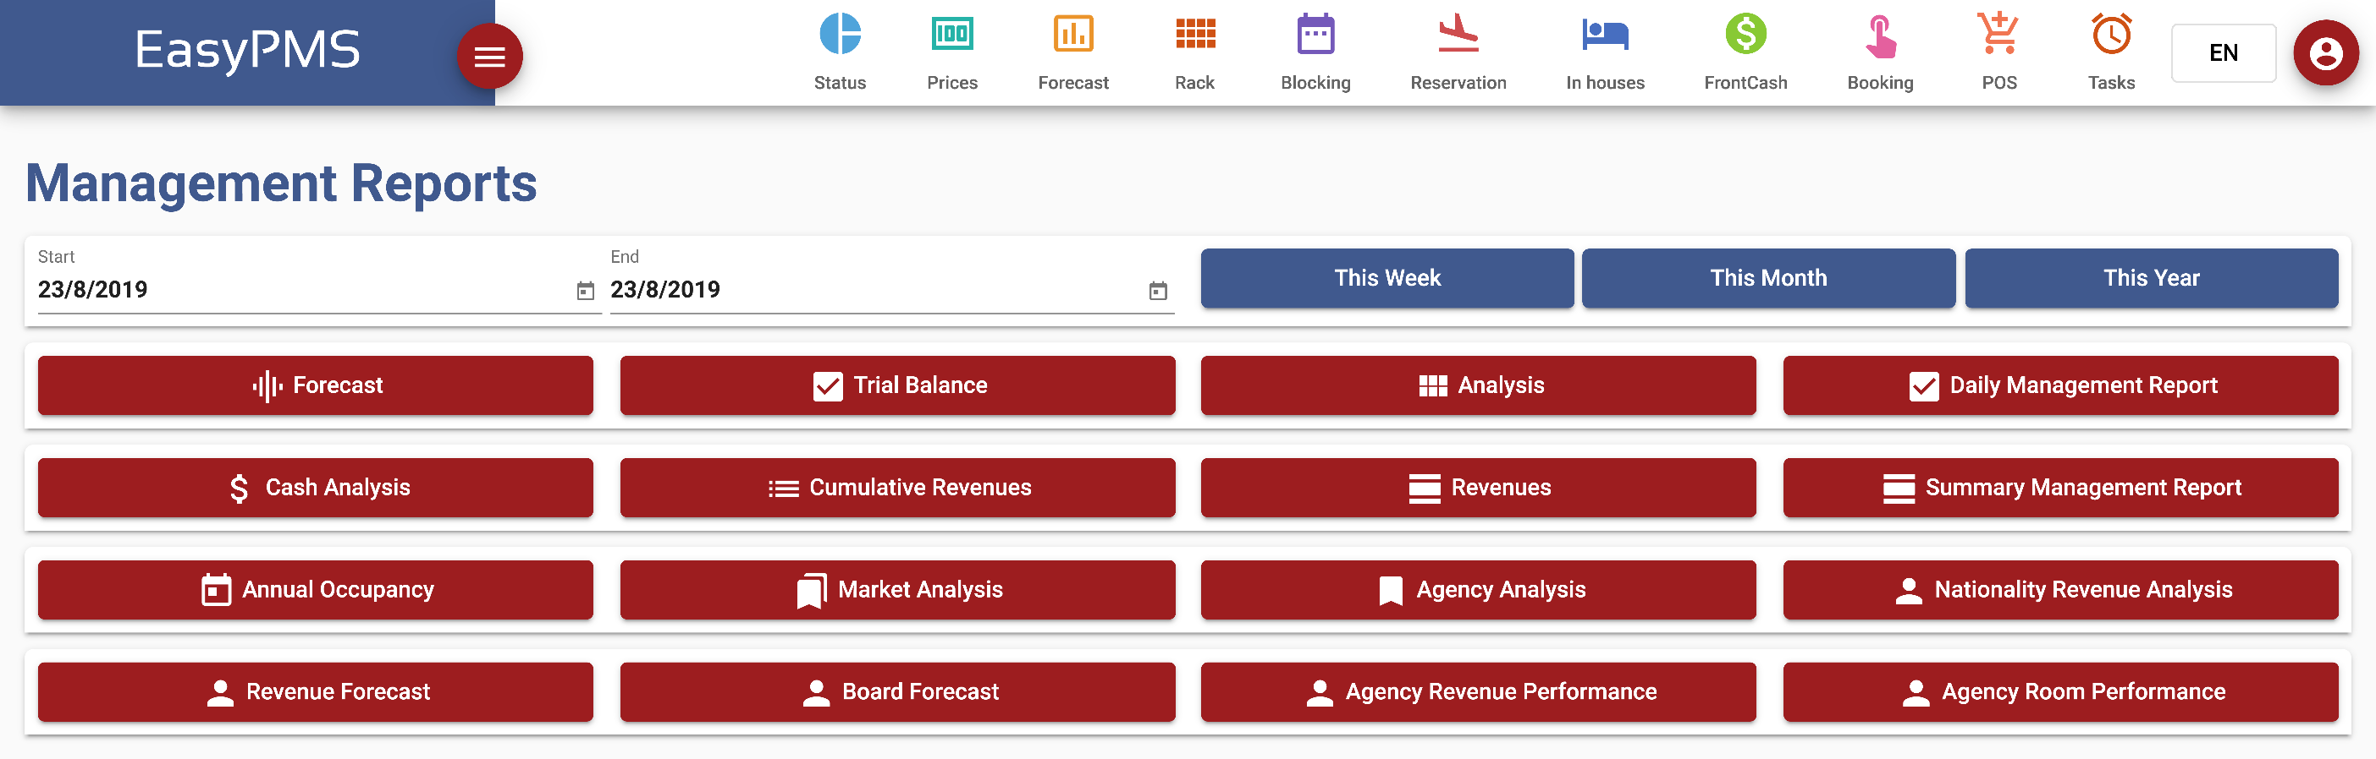
REPORTING
It provides all the financial and operational reports you need.

Slide 43
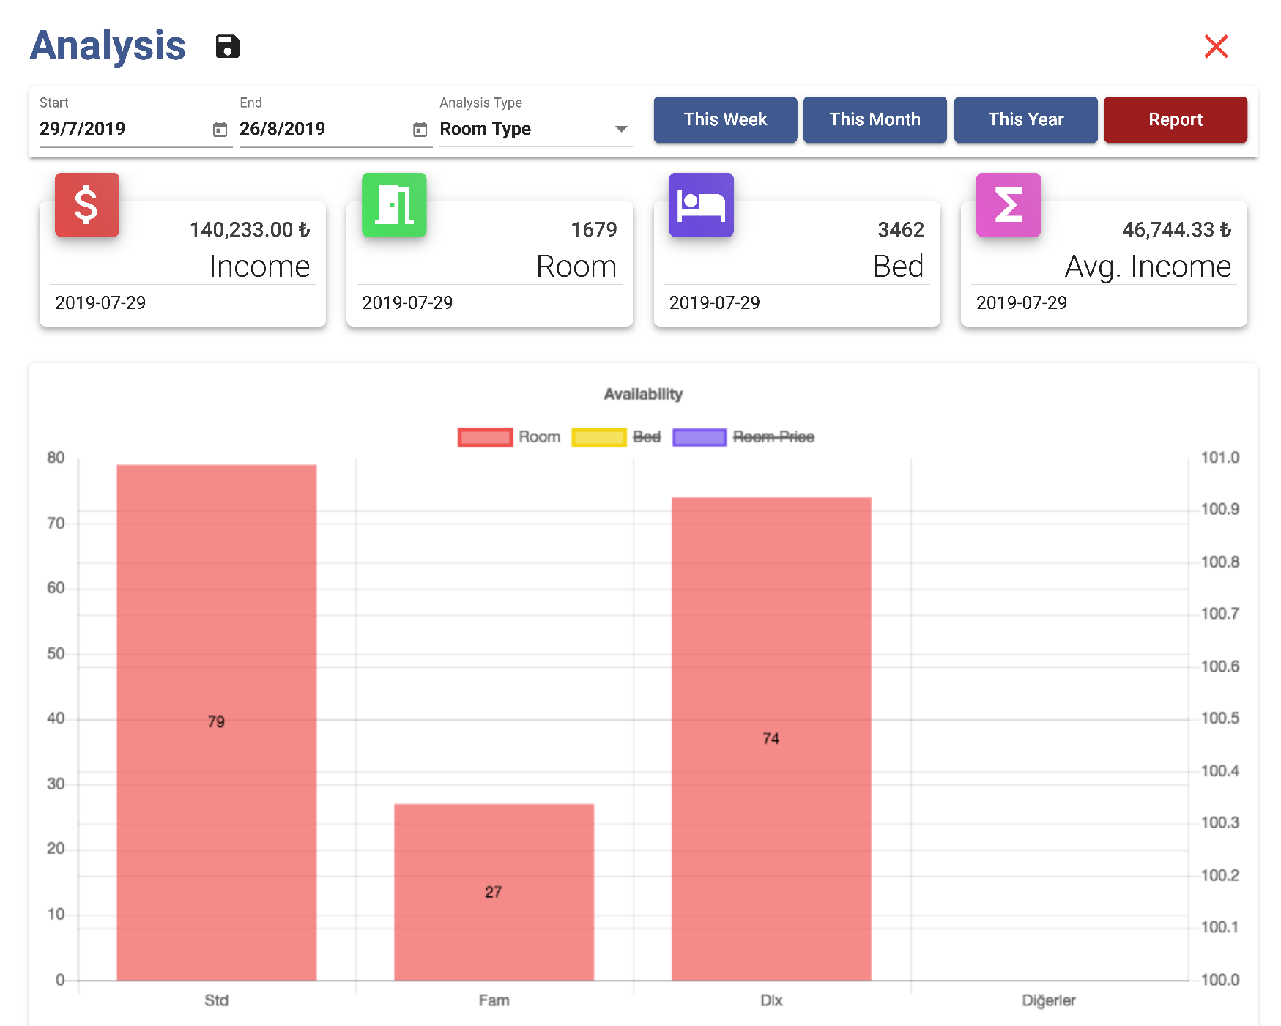
REPORTING
You can access many different graphs and analyzes thanks to the parametric structure in the reports and the easy user interface.

Slide 44
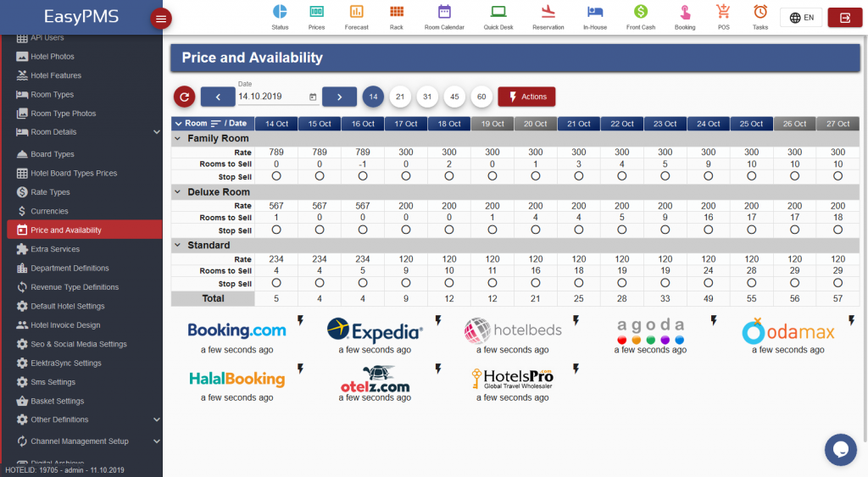
CHANNEL MANAGER

Slide 45
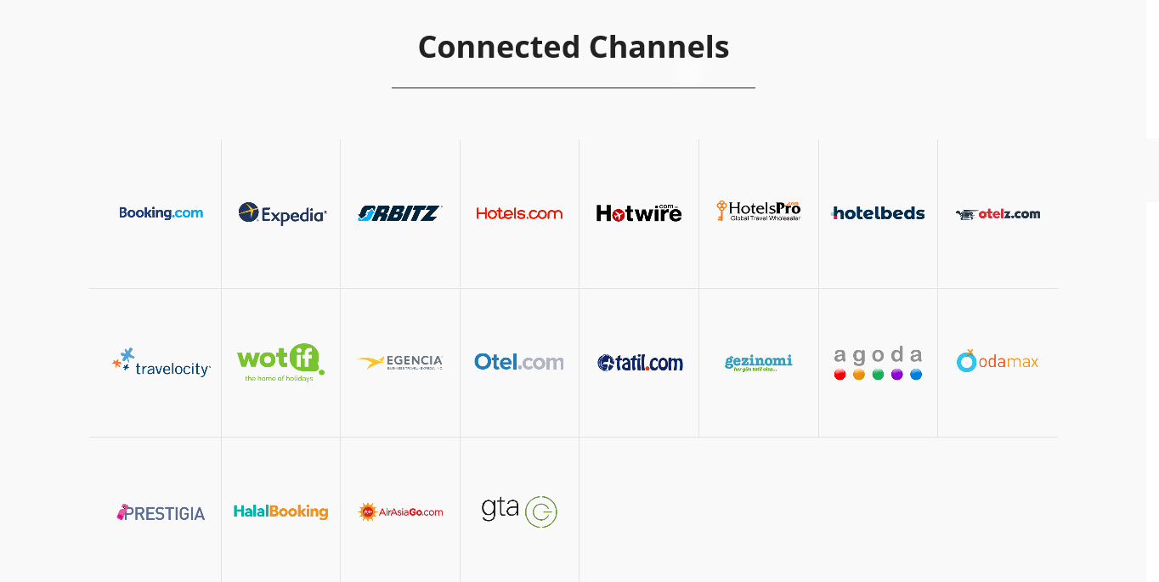
CHANNEL MANAGER
EasyPMS has an integrated channel manager which does not only synchronize online channels (Booking, Expedis, Hotelbeds, Hotelspro etc) but also receives the reservations in the hotel. That is why it is much easier and more effective.
EasyPMS has two-way connection that is occupancy information and prices are sent to channels and reservations are received.
EasyPMS channel manager system is very flexible. In addition to sending and receiving options, availability, discounts, and prices can be revised according to channels.
Virtual room types can be used and virtual room type availability can be formulated based on actual room types.

Slide 46
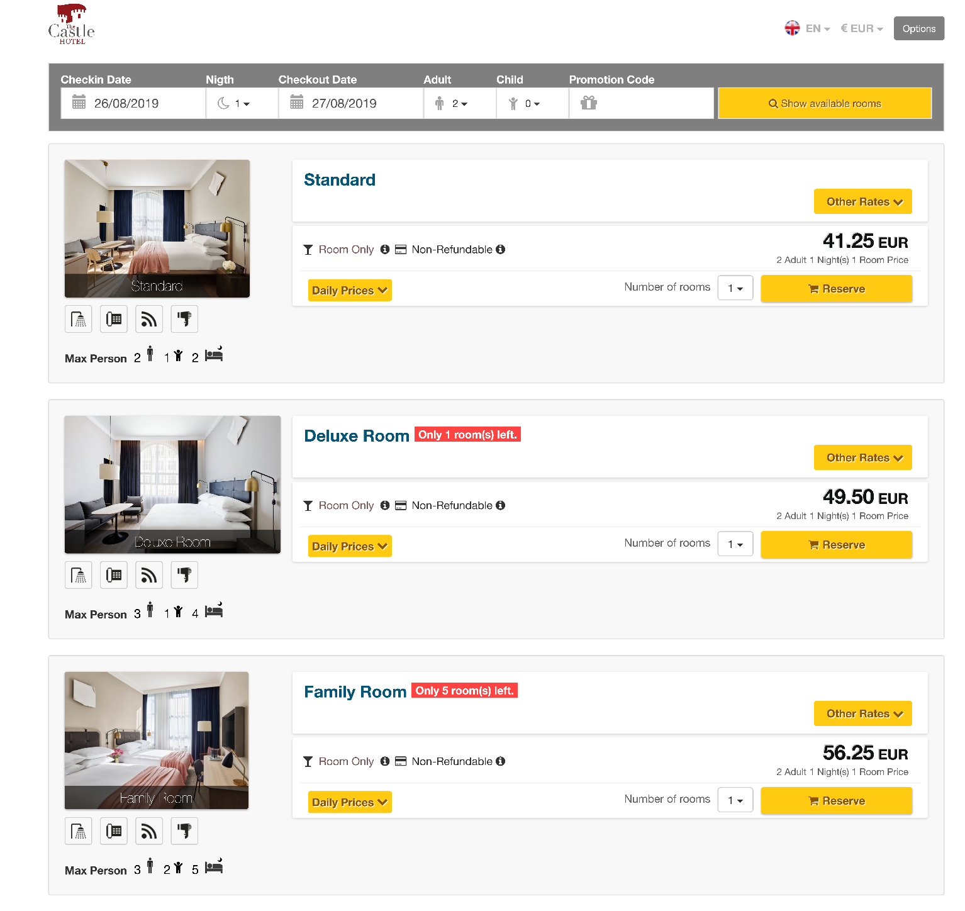
BOOKING ENGINE
It has an easy and fast interface.
The view of booking page (content, colors, font, theme, back font etc.) can be customized according to the corporate identity of the hotel.
Multiple reservations for different dates and room types can be done at once.
It provides daily price and availability for each room along with the total price.
It shows net prices besides showing prices and discounts separately.
It lists all different price options for the same room such as refundable, nonrefundable, with or without breakfast.
It is multilingual and multi currency. Daily currency rates are automatically updated.

Slide 47
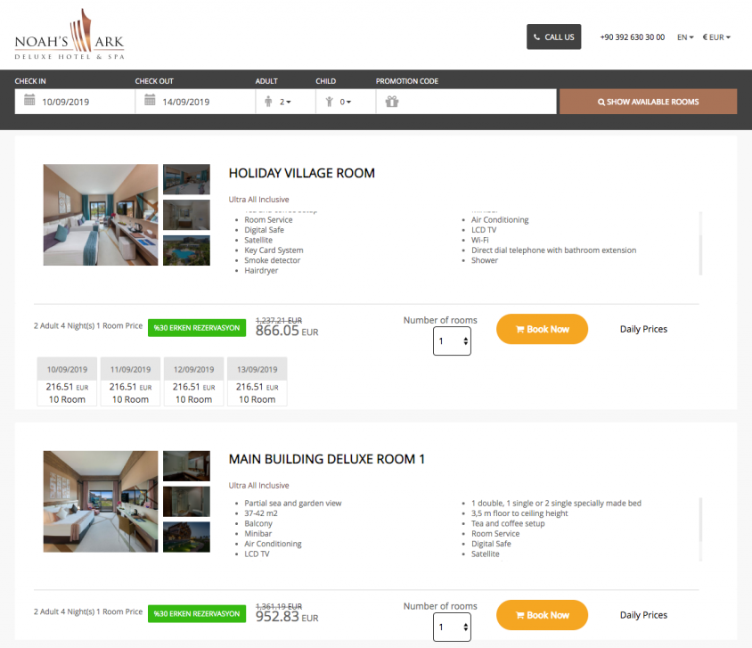
BOOKING ENGINE
During the reservation, customers can be monitored and contacted by online chat, they can click and talk, send call me forms.
When a reservation is made, it sends a notification by SMS and e-mail both to the guest and the hotel.
Different payment options such as cash, wire transfer, pay at hotel, credit card, and guarantee by credit card are provided.
Guests can use promotion codes or previously earned bonus points.
It is multilingual and multi currency. Daily currency rates are automatically updated.

Slide 48
RATE MANAGER
EasyPMS Rate Manager enables the hotels analyze the prices of their competitors in all sales channels and determine the most optimum price for their hotel to maximize their profit and occupancy.

Slide 49
RATE MANAGER
Also, EasyPMS Rate Manager enables the hotels to make predictions about the rates and occupancy by analyzing the reservations made for a certain date in the previous years.

Slide 50
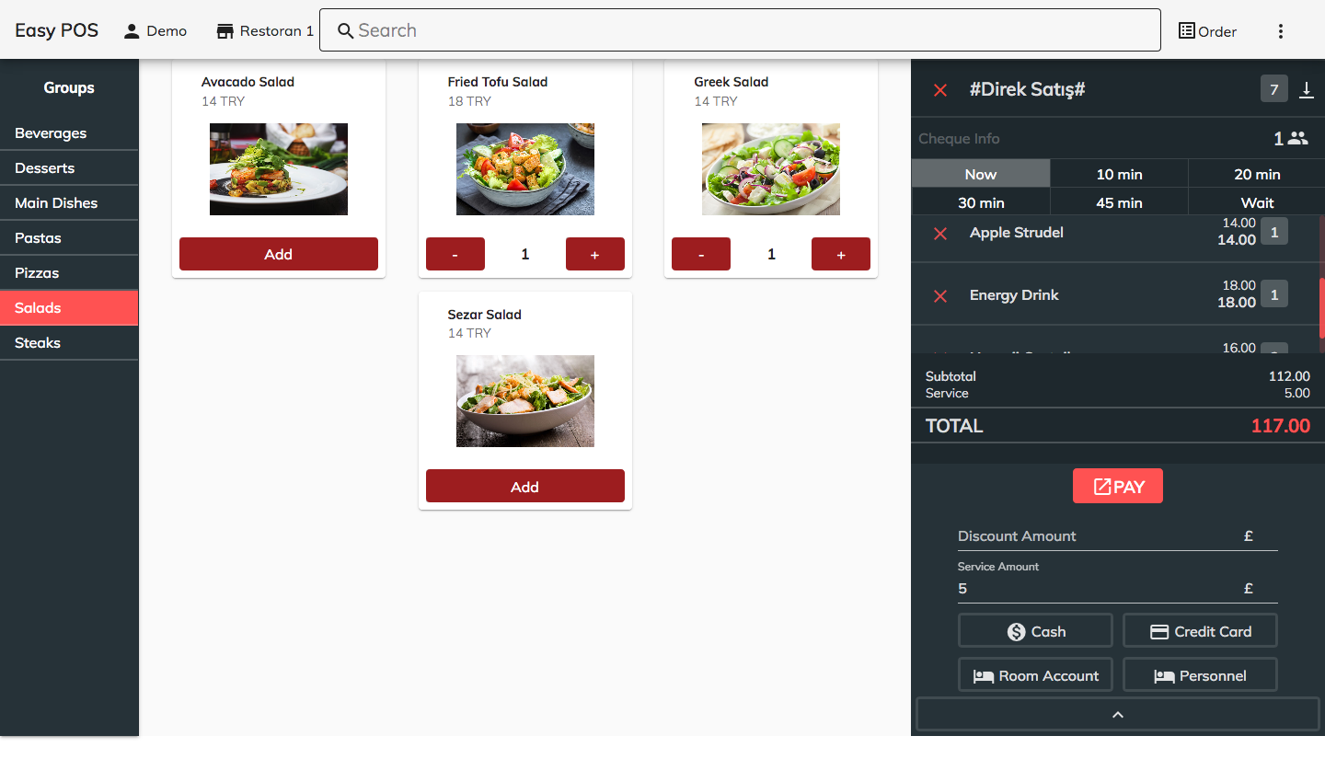
EASYPOS
EasyPOS can be used in different types of properties such as hotels, restaurants, bars, retails, and more.
Order taking, preparing, and serving processes can be followed and performance analysis can be done.

Slide 51
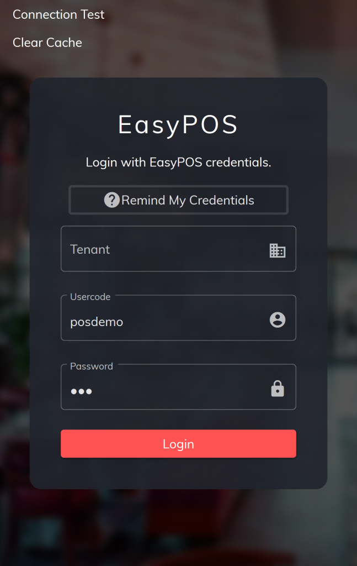
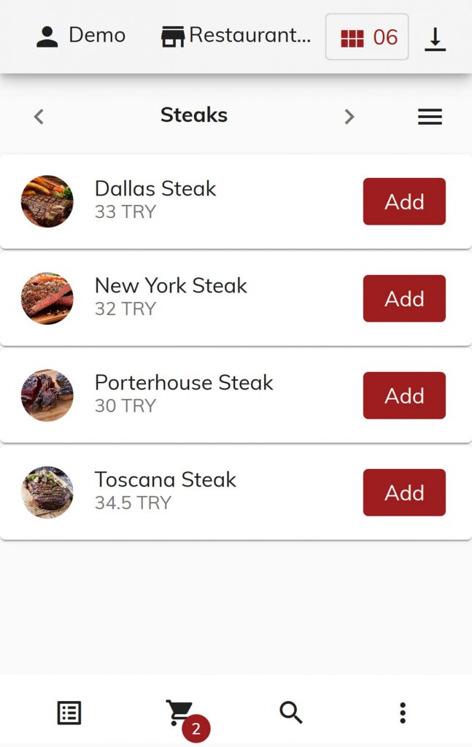
EASYPOS
EasyPOS can be used as an app on mobile devices and on the web browser.
It provides digital menu and online ordering functions for the guests.

